Slide 1
Faecal Sludge Management in transition – Case studies from India
Ravi Narayanan
Arghyam, Bangalore, India

Slide 2
Issues
Census 2011: 30 million urban households (38%) in India have septic tanks. USAID (2010)
Septic tanks not designed properly resulting in fecal contamination
In areas un-served by sewer systems, there is dumping of sewage into water bodies in and around cities.
Tankers employed for disposing the sewage usually dump the sewage at the closest point from where it was collected.
Uncontrolled disposal of septage worse than open defection.
1,000,000+
50,000 – 100,000
25,000 – 50,000

Slide 3
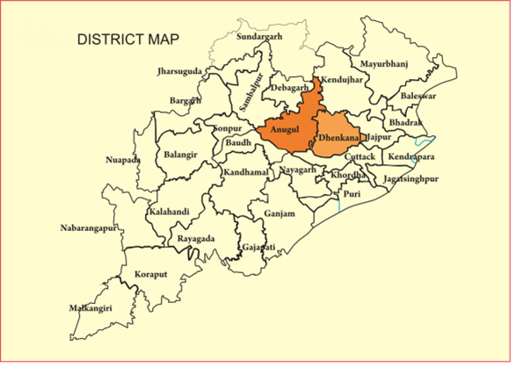
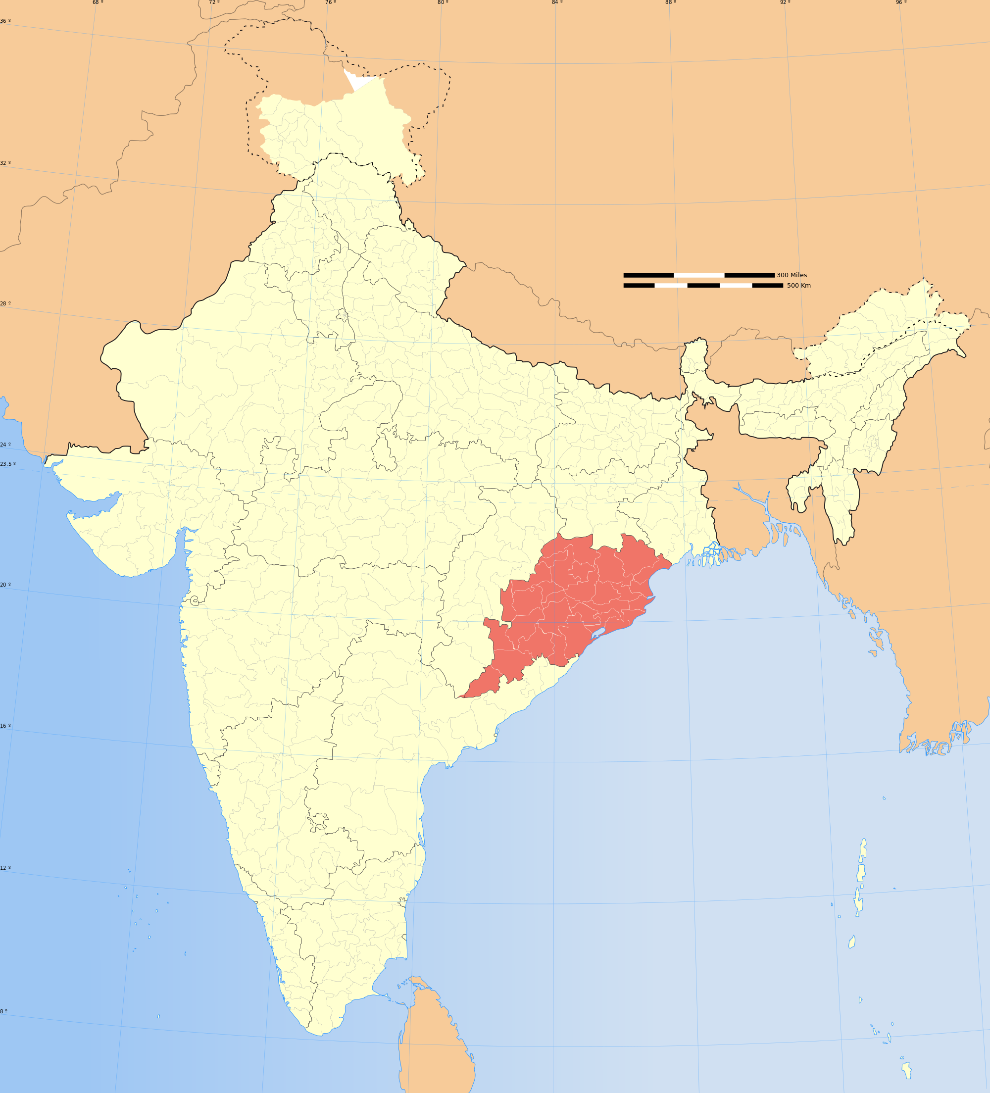
Project Nirmal: Piloting Appropriate And Sustainable Sanitation Service Delivery In Two Towns of Odisha
Project Location: Angul Municipality and Dhenkanal Municipality, Odisha, India
Duration: 3 Years

Slide 4
Introduction | Demonstration of sustainable sanitation service delivery by implementing a faecal sludge treatment plant at Angul & Dhenkanal through enabling institutional and private sector participation.
Technology
Sludge: Anaerobic digestion + sludge drying & Wastewater: DEWATS + Sand-Carbon Filter
Low O&M, simple operation, minimal skills, no electricity. But, land availability is a prerequisite
Capacity Building
10 modules for capacity building programmes to be implemented across the State:
Sanitation and it’s relevance; National and state sanitation scenario; Institutional and policy framework for wastewater management; Urban wastewater management systems; Faecal sludge management; Containment and handling of faecal sludge; Treatment and reuse/disposal; Financial management; Administration and Enforcement and FSM planning

Slide 5
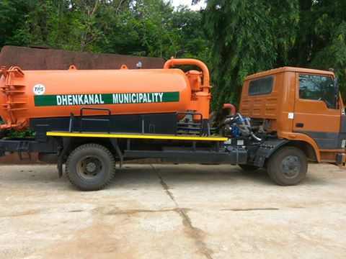
Institutional arrangement
3 cesspool trucks granted from the State Government to engage private enterprises.
The informal sweepers shall work with the private enterprises as paid employee
Municipalities shall run the treatment facility after technical capacity building and hand holding.
Cess pool purchased by both ULBs
Financial arrangement
“Demand emptying” will be established prior considering “Schedule emptying”
Profit from the emptying & transportation in demand driven service exists from the beginning.
Treatment and reuse functions are not financially viable for initial few years, requiring external financial assistance.
Leasing-out the cesspool trucks to the private operation may be an option.

Slide 6
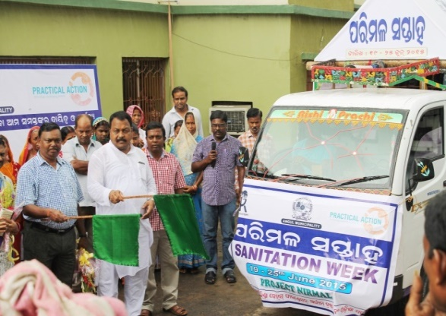
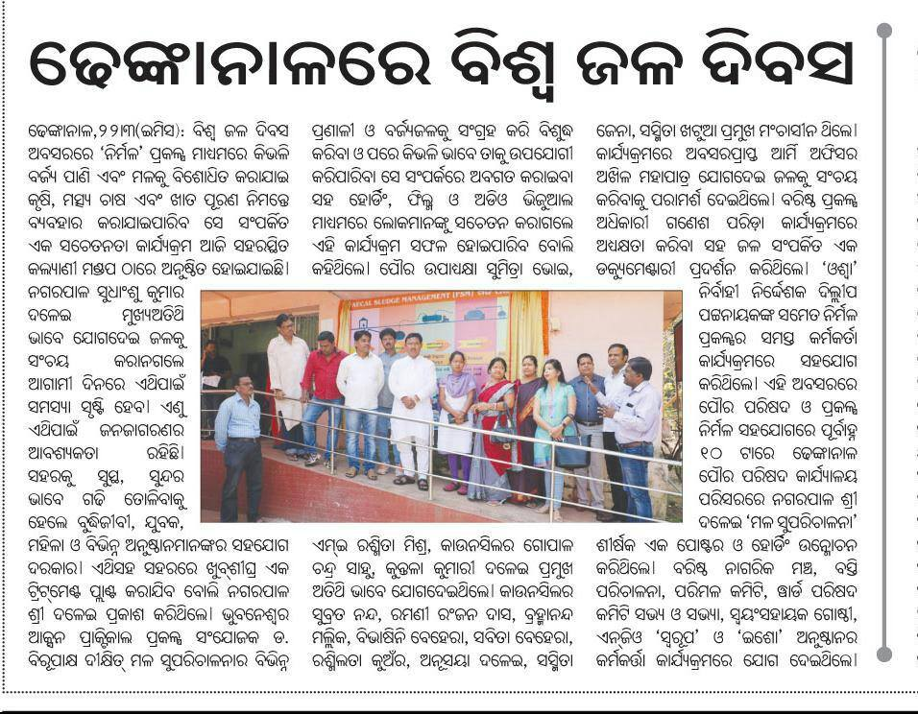
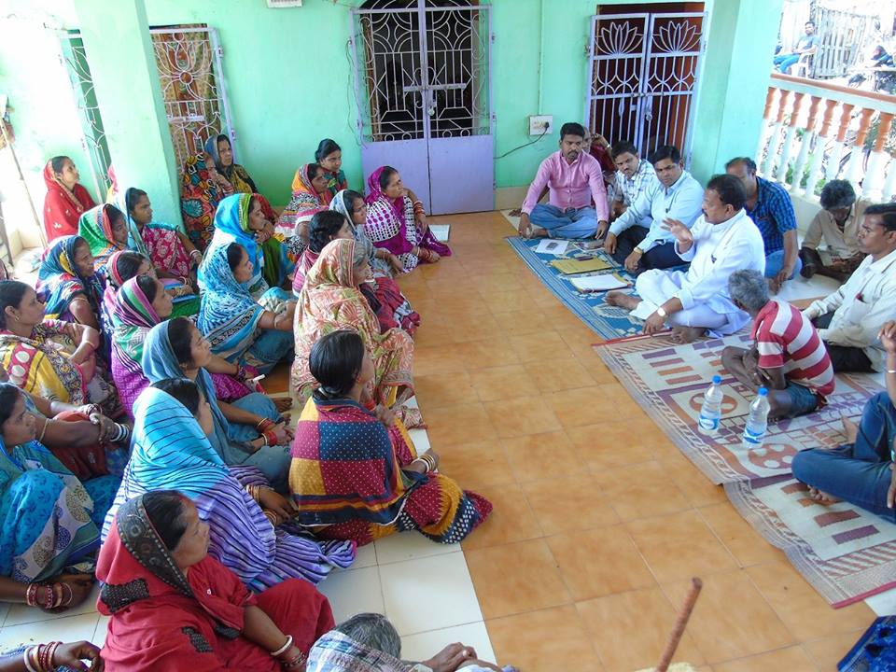
Social aspects: Public awareness, women’s involvement
A comprehensive IEC and BCC strategy developed and will be launched by the State Government to:
Ensure construction of appropriate and timely desludging of the septic tanks/pits by the households
Address negative behavior pattern among the service providers
Create understanding on end-use of treated faecal sludge
Slum Sanitation Committees - 45; Ward Sanitation Committees – 46 with a focus to build bridge between communities & ULBs
Women participation in Slum Sanitation Committees is high representing more than 50%.
IEC activities
Slum Sanitation Committee Meeting

Slide 7
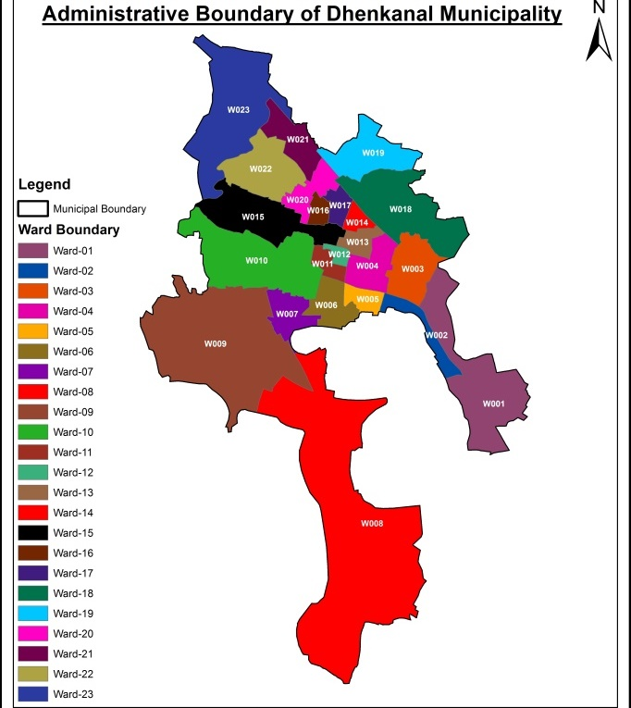
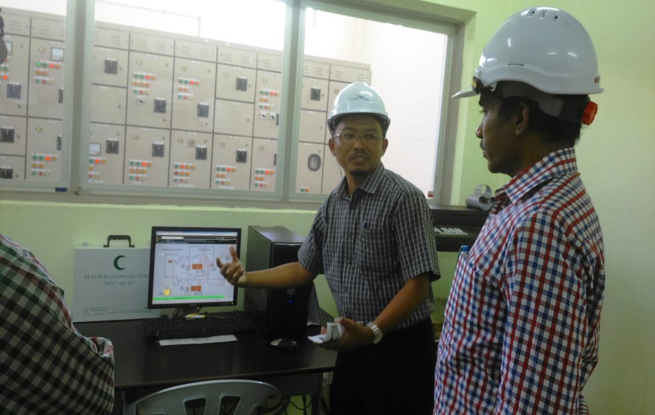
Outcomes & Impacts
State Government and the ULBs demonstrated commitment to urban sanitation service delivery
Technical capacity of the State and ULBs augmented by establishing Project Management Units (PMU)
Small cities introduced to data-based GIS planning tools by mapping situational assessment
Community level demand generation for city- wide sustainable sanitation through IEC strategy & Committees
Urban sanitation training programmes institutionalized in regular state training for urban cadre
The Government officials visit to Malaysia (IWK) resulted in investing on septage management at State level
Challenges
Informal sweepers still dominating through manual emptying
Lack of timely support from Government to implement the program - Ex: Signing MoU took 7 months
Fragmented Political dynamics at the city level
Lack of awareness at city and community level
Change in Bureaucracy/transfers of Government officials
Allotment of land for FSTPs
Secretary, HUDD, Govt. of Odisha visiting IWK, Malaysia
GIS based data planning

Slide 8
Key messages
Without the following no progress possible:
Land availability and allotment. Process for land allotment to be started from the beginning of project in view of lengthy governmental procedures
Appropriate engagement of stakeholders at various intervention period creates better results
Mass awareness required to institutionalize the FSM concept at State level
Financing strategy
Funding for capital cost: Bill and Melinda Gates Foundation; Operation of the plant: Implementing agency for one year with funding support; Post one year: Transferred to the Municipality for regular O&M
Business model - FSM
1. Digested Sludge: Arrived at 3 models using financial modelling exercises
2. Wastewater: About 4 cum treated water - utilized within plant; rest flows in agricultural fields.

Slide 9
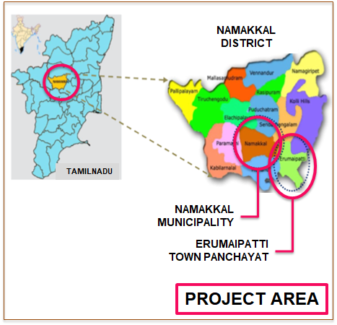
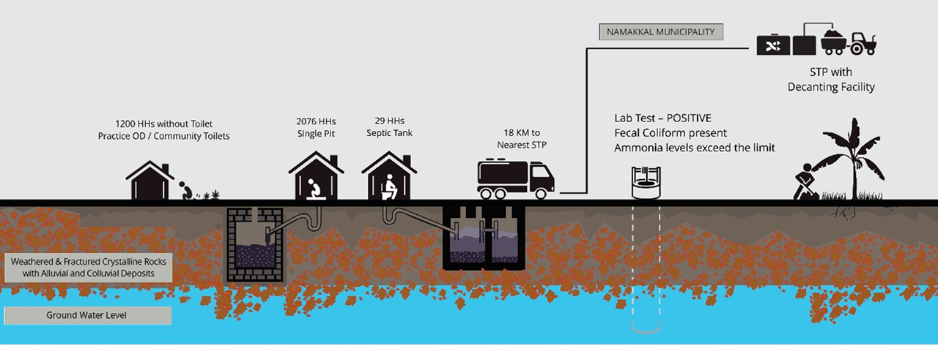
Project Tuymai : Developing Implementation Framework For Faecal Sludge Management Service Delivery In Small Towns
Project Location: Erumapatty Town Panchayat, Tamil Nadu
Duration: 2 years

Slide 10
Introduction | To study the existing FSM practices and service delivery, the design and construction of septic tanks and develop a sustainable framework to implement septage guidelines in small towns of Tamil Nadu.
Technology
A hybrid model: Efficient liquid waste management strategy using a lifecycle approach with the combination of onsite sanitation systems and solids free sewer system
Proposed a local faecal sludge treatment facility (Bio-digestor / Anaerobic baffled reactor (ABR) - Anaerobic filter (AF) / sludge drying bed and co-composing / Horizontal Planted Gravel Filter)
Capacity Building of Institutions
Regulate new toilet construction
Empanel masons & desludging operators and regular monitoring of their services
Selling of end products from FSTP/STP
Conduct desludging services as per the dos and don'ts established in the city
Social aspects: Public awareness, Women’s involvement
Door to door campaign to orient the households on establishing proper septic tanks, pit latrines and solid waste management with source segregation.
Meetings with community leaders and women SHGs on source segregation of waste and usage of toilets.

Slide 11
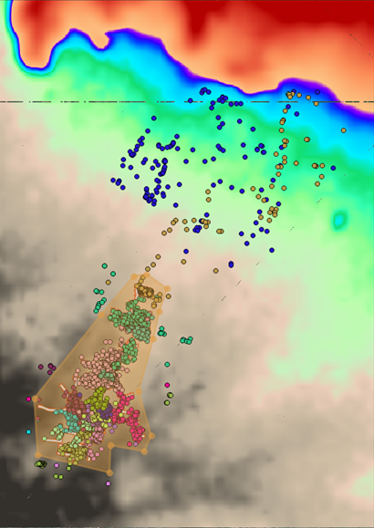
Outcomes and Impacts
The sensitivity levels increased substantially on FSM within the ULBs
Erumaipatty Town Panchayat, agreed to provide site to implement FSM
ULBs have improved their septic tank approval mechanisms as per Government norms
Challenges
Lack of policy direction
Cost of implementation
Availability of land for implementation in other towns
Scope for implementing technology innovations limited
No incentives for upgrading defunct/poorly designed septic tanks.
Key Messages
Cities/Towns should think the diversity of situations, especially liquid waste management strategy amenable to its city conditions:
City’s hydrogeological conditions and City’s topography
Habitation dispersion and landuse pattern
No “One size fits all” solutions
Scattered settlements in Erumaipatti Town

Slide 12
Financing strategies For Erumapatty
CAPEX: Approximately INR 165.8 millions (USD 2,586,987)
Source: (a) Municipal borrowing and pooled finance mechanism, (b) State Finance Commission funds, (c) Viability gap funding (State/Central), (d) CSR, Social impact investor, Donor funding
OPEX: Approximately INR 8.4 millions (USD 1,310,657)
Business model - Wastewater and Sludge management
About 25 km of sewerage network proposed to cater 2971 HHs and 334 HHs by onsite sanitation facilities for scattered settlements (for total population of 13,439). As the town is having a natural gradient, the treatment facility is proposed at one of the available site.
Proposed to operate on Build-Operate-Own-Transfer (BOOT) model with the available operators with regulated desludging price and reporting methods.
Source of O&M cost: Sanitation tax (part of property tax) or household contributions, resale of by-products (recycled wastewater to aquaculture & compost to agriculture).

Slide 13
Cost comparison of FSTPs in India – Implemented and Proposed Projects
Particulars | Devanahalli, Karnataka Status: Implemented | Leh, Jammu & Kashmir Status: Implemented | Dhenkanal, Odisha Status: DPR drafted | Erumapatty, Tamil Nadu Status: Research study
Municipal area | 16 km² | 9 km² | 31 km² | 4.5 km²
Municipal wards | 23 | 21 | 23 | 15
Population (2011) | 28309 | 30,870 | 67,414 | 13,439
Households (2011) | 6400 | 4,377 | 14,908 | 3305
Toilet coverage
HHs without toilets | 620 (10%) | 127 (3%) | 3776 (25%) | 2105 (64%)
HHs with toilets | 5780 (90%) | 4250 (97%) | 11,132 (75%) | 1200 (36%)
UGD | 0 | 285 (7%) | 463 (3%) | 0
Septic tanks | 578 (10%) | 306 (7%) | 9,056 (61%) | 29 (1%)
Single/Twin pit | 4508 (78%) | 3248 (74%) | 1,611 (11%) | 2076 (99%)
Open drains/others | 116 (2%) | 394 (9%) | 0 | 0
Details of the FSTP
Design capacity | 9 m³/day | 12 m³/day | 27 m³/day | 330 m³/day
Capex | ₹ 90,00,000 (₹ 300/Capita) | ₹ 52,00,000 (₹ 168/Capita) | ₹ 2,96,32,771 (₹ 440/Capita) | ₹ 16,58,00,000 (₹ 12,337/Capita)
Opex | ₹ 24,00,000/year (₹ 80/Capita) | ₹ 10,00,000/year (₹ 32/Capita) | ₹ 9,56,733/year (₹ 14/Capita) | ₹ 84,00,000 (₹ 625/Capita)
Tariff | ₹ 3,960/trip | ₹ 3,500/trip | ₹ 1100/trip | Yet to plan
Funded by | BMGF | BORDA | BMGF | Yet to plan
Service provided by | Municipality | BlueWater Company, Leh | PPP (Yet to plan) | Yet to plan

Slide 14
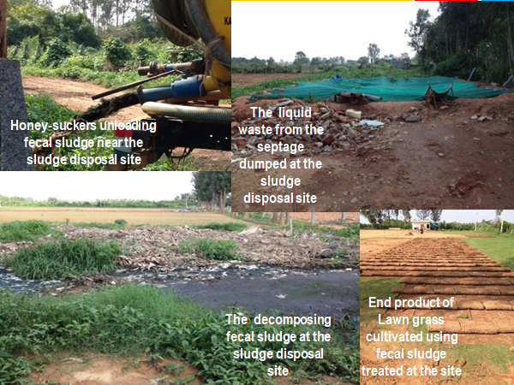
Conclusion
FSM - under-invested, huge need
Currently, only sewered networks seen as a solution but this is just not feasible for smaller towns
Managing Rural – Urban Continuum (Challenges of transition)
Need for:
Models for decentralized FSM management based on data (financial, technical, institutional, and social) and scientific studies
Principle of subsidiarity
Local resources first
Accountable Government & engaged citizenry
Technology upgrades that can pay for itself
Closing the loop (Emphasize on reuse)

